Slide 1
Revenue Insights for Atliq Grand Hotel Chain
Created as part of the Hospitality Challenge by CodeBasics
Meet Patel

Slide 2
Objective
Goal
Focus Areas
Develop a dashboard for the Revenue Management team to identify trends and improve revenue efficiency.
1. Revenue trends 2. Property performance 3. Booking behavior

Slide 3



Approach
Data Preparation
Modeling & Analysis
Dashboard Creation
Cleaned and transformed data in Power Query
Established relationships between tables
Built visualizations to highlight key metrics

Slide 4
Key Insights
$ 1.69B
57.8%
$117M
3.62
Revenue
Occupancy Rate
Top Property Atliq Exotica, Mumbai
Average Rating

Slide 5



Tools Used
Power BI
Excel
Key Skills
Visualization Tool
Data Source
Data transformation, modeling, and DAX

Slide 6
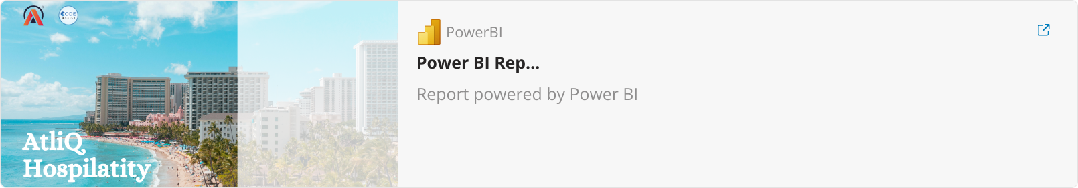
Dashboard

